Slide 1

TubePulse:
Harnessing YouTube Insights Using The Cloud
Abhigna Sowgandhika Vadlamudi Geethika Komma Kausthubh Reddy Eleti
2268166 2263649 2297857
avadlam2@cougarnet.uh.edu
gkomma2@cougarnet.uh.edu
keleti@cougarnet.uh.edu

Slide 2
INTRODUCTION
This project aims to securely manage, streamline, and perform analysis on the structured and semi-structured YouTube videos data based on the video categories and the trending metrics. A few use-cases are:
Notes:
Thus, this platform can be a powerful tool for content creators, marketers, advertisers, and businesses to make data-driven decisions and enhance user experience.

Slide 3
INTRODUCTION
This project aims to securely manage, streamline, and perform analysis on the structured and semi-structured YouTube videos data based on the video categories and the trending metrics. A few use-cases are:
Content Strategy Optimization
User Engagement Analysis
Ad-campaign and Monetization
Audience Segmentation
to analyze the performance of a user’s content and develop a strategy to produce more appealing and relevant videos.
helps in better understanding of the demographics and preferences of the audience which allows improved segmentation.
to analyze sentiment in comments and understand audience reactions.
allows us to analyze viewer behavior, watch time, ad performance which can lead to better decisions on ad placements.
Notes:
Thus, this platform can be a powerful tool for content creators, marketers, advertisers, and businesses to make data-driven decisions and enhance user experience.

Slide 4
OBJECTIVES
Data Lake
Process: Establish a data lake on Amazon S3 for centralized and organized storage.
Outcome: Efficient data retrieval and management.
Data Ingestion
Process: Utilize AWS CLI for uploading
raw data to Amazon S3.
Outcome: Centralized storage of
YouTube video statistics.
05
01
04
Scalability
Process: Design a scalable system capable of handling high data volume.
Outcome: Ensure the system's ability to grow with expanding data.
ETL System
Process: AWS Glue crawlers for cataloging, Lambda functions for data transformation.
Outcome: Structured and clean
data ready for analysis.
02
03
Reporting
Process: Create a reporting dashboard using Amazon QuickSight.
Outcome: User-friendly insights into YouTube video analytics.

Slide 5
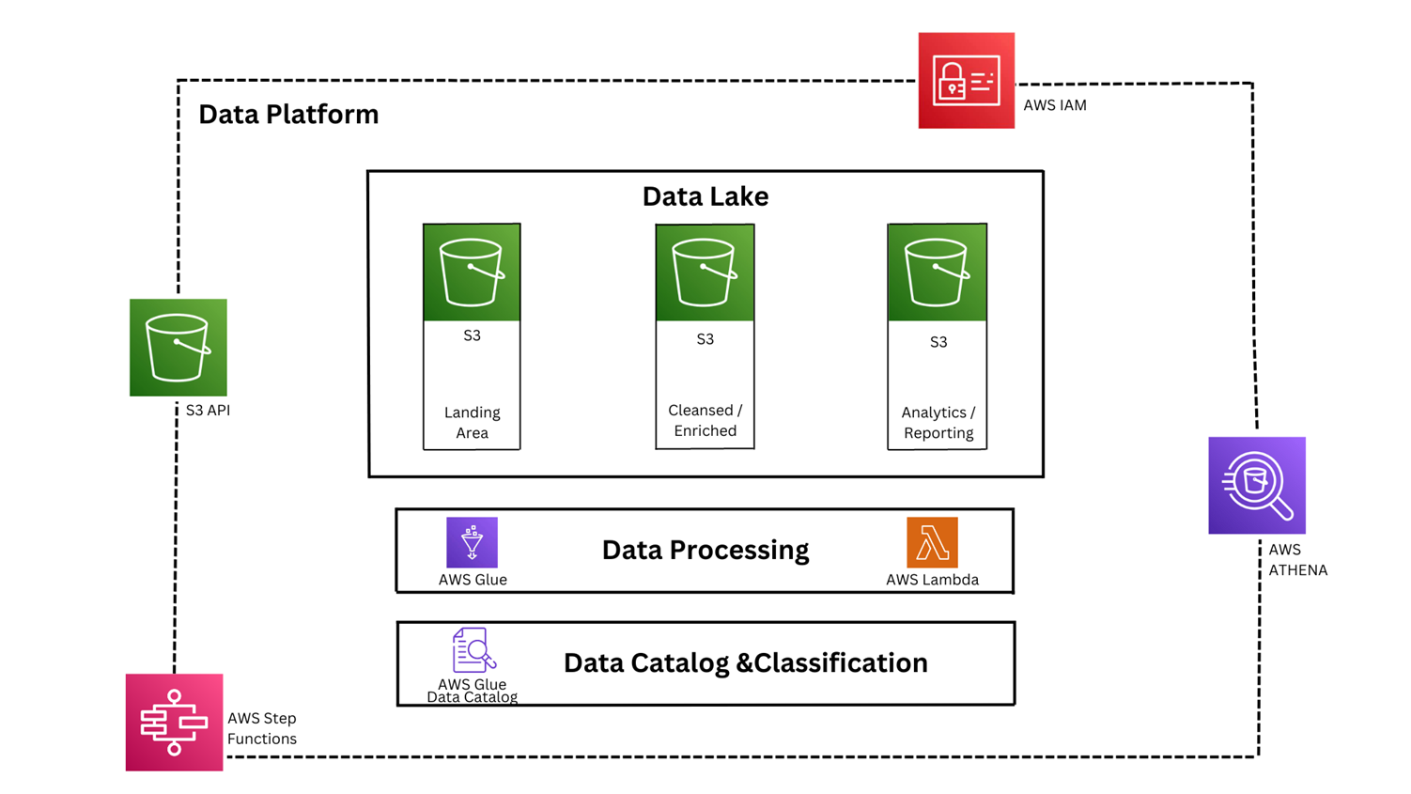
ARCHITECTURE
©SOCC '13: Proceedings of the 4th annual Symposium on Cloud Computing, YARN

Slide 6
IMPLEMENTATION
1. Data Ingestion: AWS CLI is used to upload raw data to S3 bucket.
2. ETL System: AWS Glue crawlers are implemented for cataloging while lambda functions are used to enable data transformation.
3. Data Lake: Centralized and structured data lake on Amazon S3.
4. Scalability: The system is designed to handle growing data volumes effectively.
5. Cloud Services: IAM roles are specified for secure access. AWS Glue is used for data cataloging, lambda functions for data processing and AWS Athena for interactive queries.
6. Reporting: Reporting dashboard is created using Amazon QuickSight.
Notes:
Let us now look into YARN’s real-world installations. The authors first shared their experience of running YARN at Yahoo and then followed it with multiple frameworks that have been ported to YARN.
Define protocols/libraries and provide framework for custom application development
Share same hadoop cluster across applications, container allocations based on locality, memory, etc
Compact scheduling protocol
Multiple versions of same app can co exist leading to experimentation
Common services needed to build distributed application are included in a pluggable framework, distributed file sharing service

Slide 7
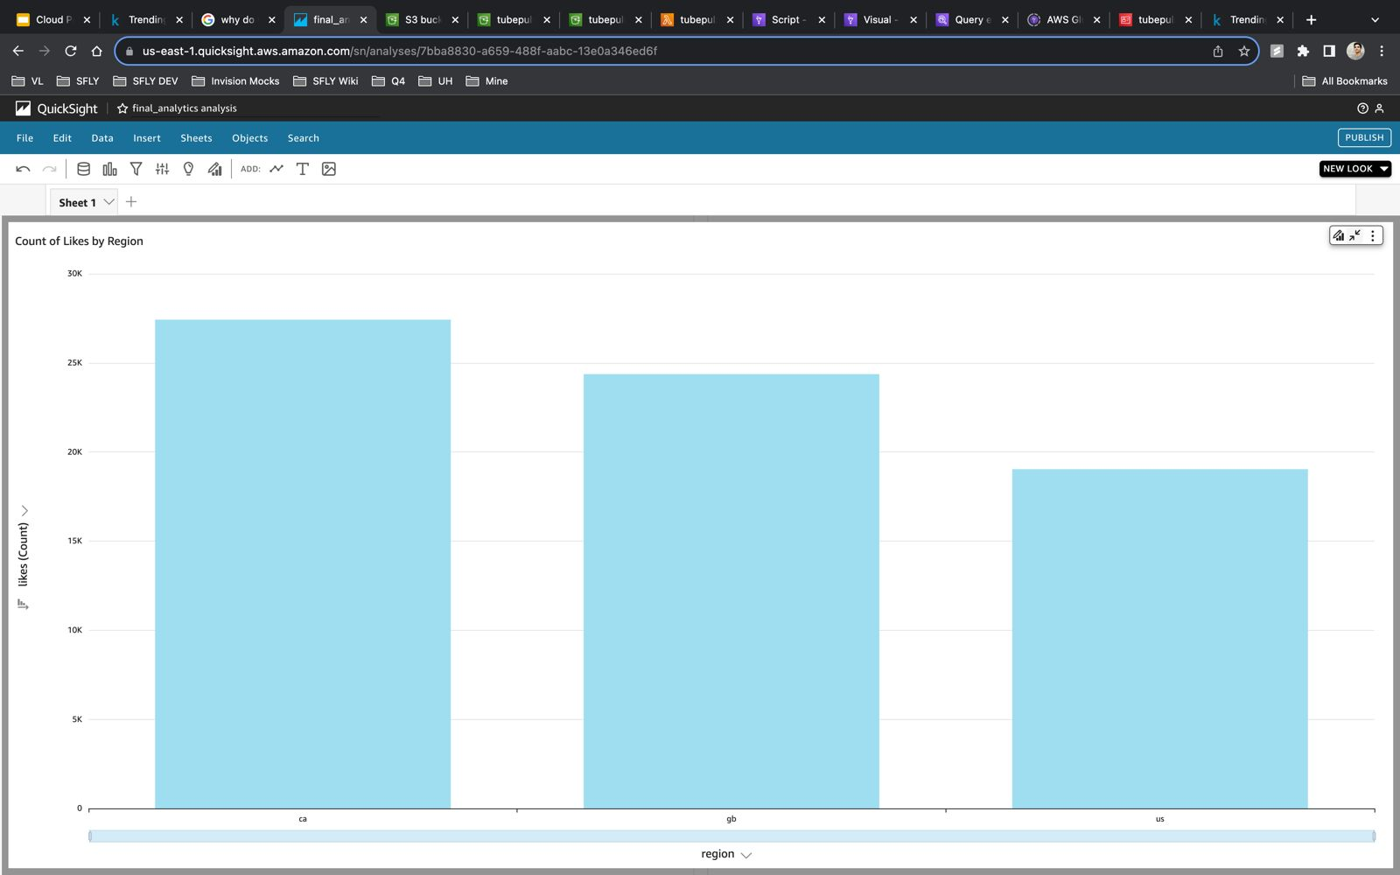
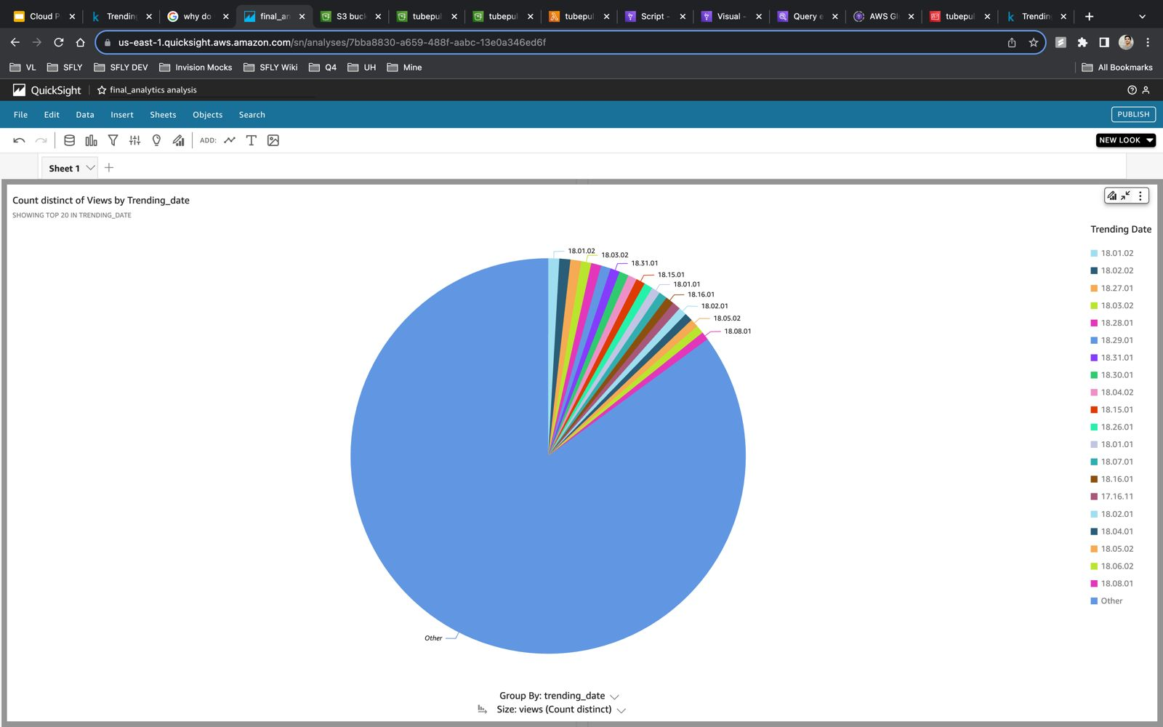
DASHBOARDS
Count of Views by Trending Date
Count of Likes by Region
Notes:
Let us now look into YARN’s real-world installations. The authors first shared their experience of running YARN at Yahoo and then followed it with multiple frameworks that have been ported to YARN.
Define protocols/libraries and provide framework for custom application development
Share same hadoop cluster across applications, container allocations based on locality, memory, etc
Compact scheduling protocol
Multiple versions of same app can co exist leading to experimentation
Common services needed to build distributed application are included in a pluggable framework, distributed file sharing service

Slide 8
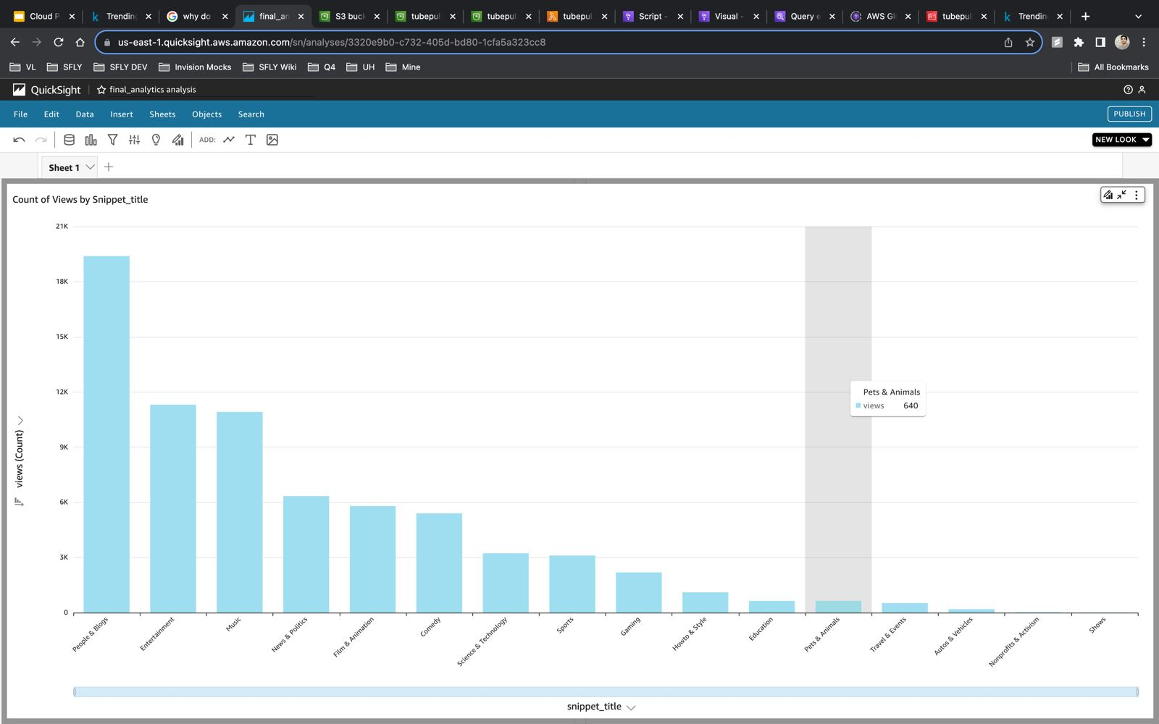
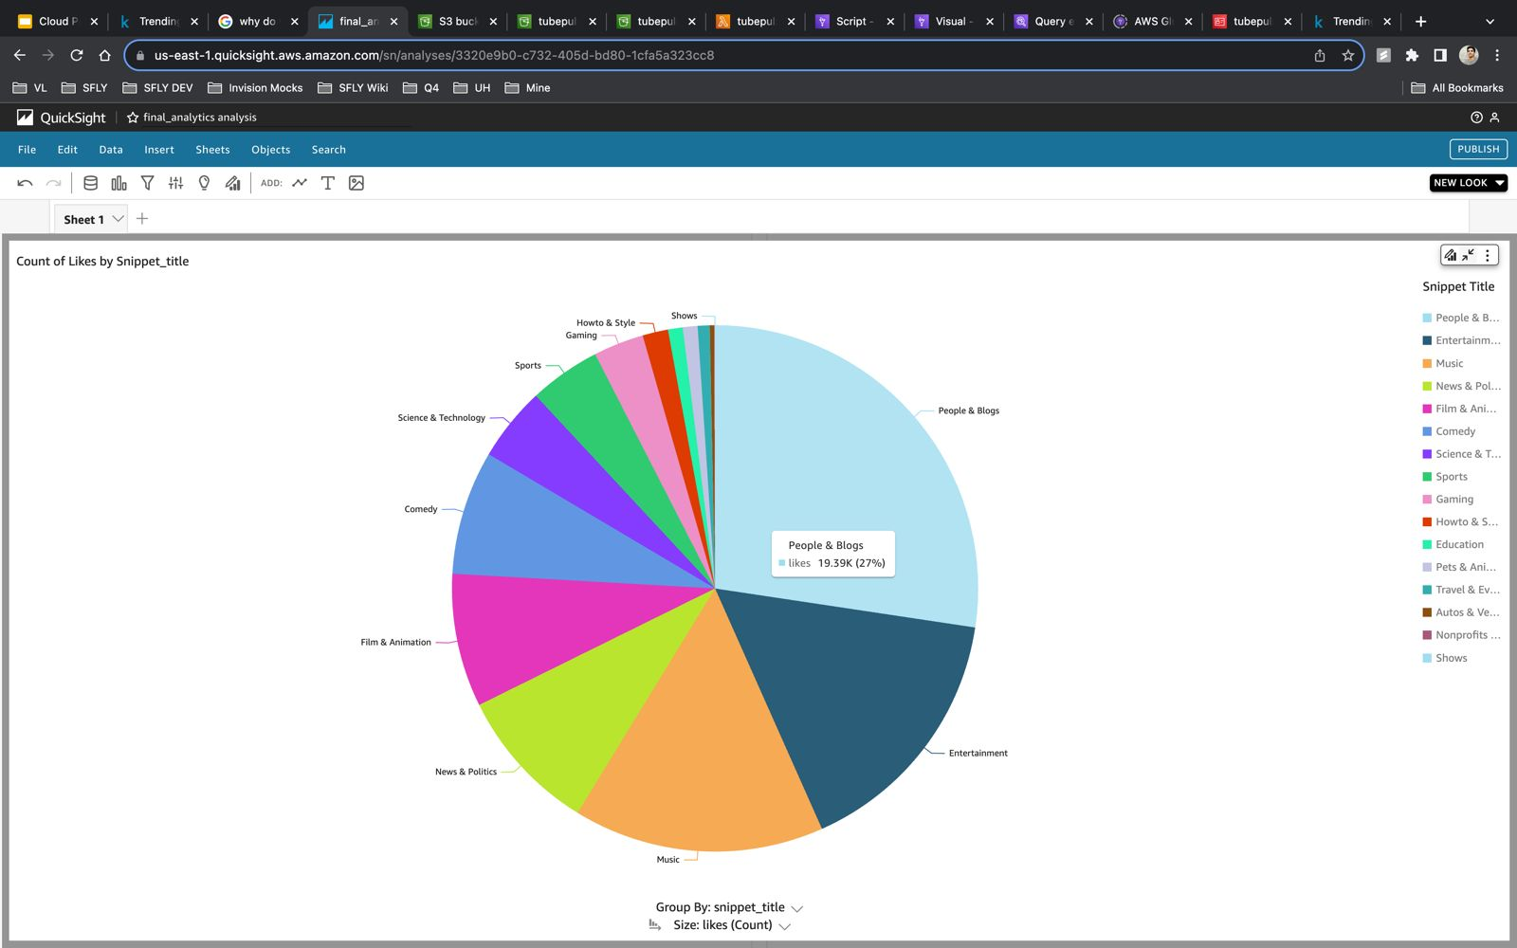
DASHBOARDS
Count of Likes by Snippet_title
Count of Views by Snippet_title
Notes:
Let us now look into YARN’s real-world installations. The authors first shared their experience of running YARN at Yahoo and then followed it with multiple frameworks that have been ported to YARN.
Define protocols/libraries and provide framework for custom application development
Share same hadoop cluster across applications, container allocations based on locality, memory, etc
Compact scheduling protocol
Multiple versions of same app can co exist leading to experimentation
Common services needed to build distributed application are included in a pluggable framework, distributed file sharing service

Slide 9
CONCLUSION
Achievements:
Successful data ingestion, transformation, and cataloging.
Establishment of a scalable data lake on AWS.
Efficient utilization of AWS cloud services for analytics.
Next Steps:
Implement scheduled ETL jobs for incremental data updates.
Enhance the reporting dashboard for a more intuitive user experience.
Explore machine learning applications for predictive analysis.
Continuously monitor and optimize the system for performance and cost efficiency.
Notes:
Let us now look into YARN’s real-world installations. The authors first shared their experience of running YARN at Yahoo and then followed it with multiple frameworks that have been ported to YARN.
Define protocols/libraries and provide framework for custom application development
Share same hadoop cluster across applications, container allocations based on locality, memory, etc
Compact scheduling protocol
Multiple versions of same app can co exist leading to experimentation
Common services needed to build distributed application are included in a pluggable framework, distributed file sharing service

Slide 10
THANK YOU

